Slide 1

Group 15 CSIRO Presentation
Afeef Ahmed
Alexandra Ellison
Matthew Oxley
Max Grant
Tajkinur Rahman
Notes:
https://macquarie.zoom.us/j/87408838170

Slide 2
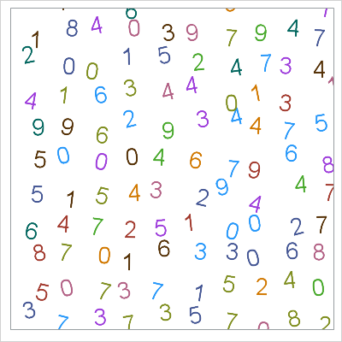
The Importance of Randomness
Random number generators are important in society
We want to find an unbiased random number generator that can be accessed by multiple parties
Random numbers are currently generated with computers, however can be interfered with
Instead, we want to look at naturally occurring random numbers, that cannot be replicated
Notes:
Alexandra

Slide 3
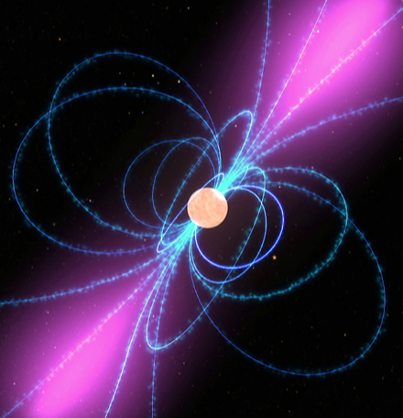
Introducing Pulsars
Pulsars are rapidly spinning stars that emit light beams
These light pulses are thought to be of random brightness
Therefore, the measure of brightness might provide us with a random number sequence
The CSIRO asked us to investigate the brightness data of 6 specific pulsars
Our aim is to conclude whether the pulses from these pulsars are truly random
Notes:
Alexandra

Slide 4
Our Task
Some adjacent pulses are correlated over time, and are evidently not random
We want to remove these correlated pulses and test for randomness
Do this by extracting a subset of pulses from the data, as per the calculated autocorrelation function
Then, test this subset for randomness, eliminating the observed correlation or ‘pattern’
Notes:
Alexandra

Slide 5
The Data
All the six pulsars datasets undergoes analysis
J0437-4715
J0953+0755
J0835-4510
J1243-6423
J1456-6843
J1644-4559
We first start off with examining our dataset and determine if data cleaning and uniforming process is required. This is done to fix any data that has incorrect, inaccurate, incomplete to the data set.
We then carry out various plots to get a visual understanding of the data
Notes:
Afeef

Slide 6
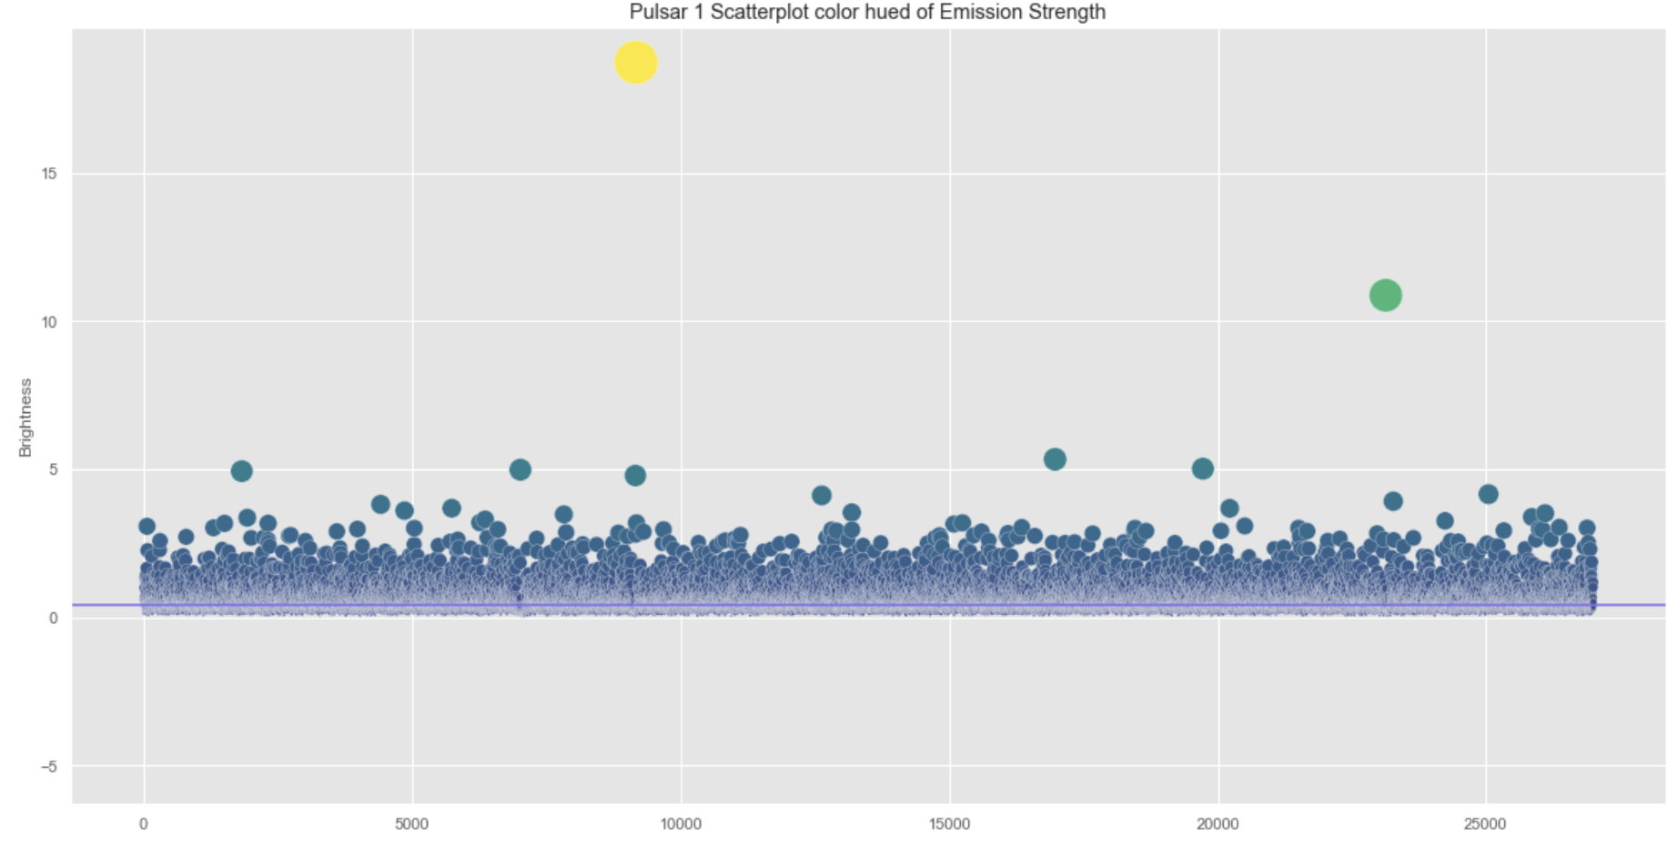
Analysis of the scatterplot
Looking at the the scatterplot of the pulsar 1 we can say that the data points are randomly scattered and there is no pattern seen. We can observe that there are two data points that have an unusual high value compared to the rest. As we measure the median, these outliers are unlikely to impact the results of the test.
Notes:
Afeef

Slide 7
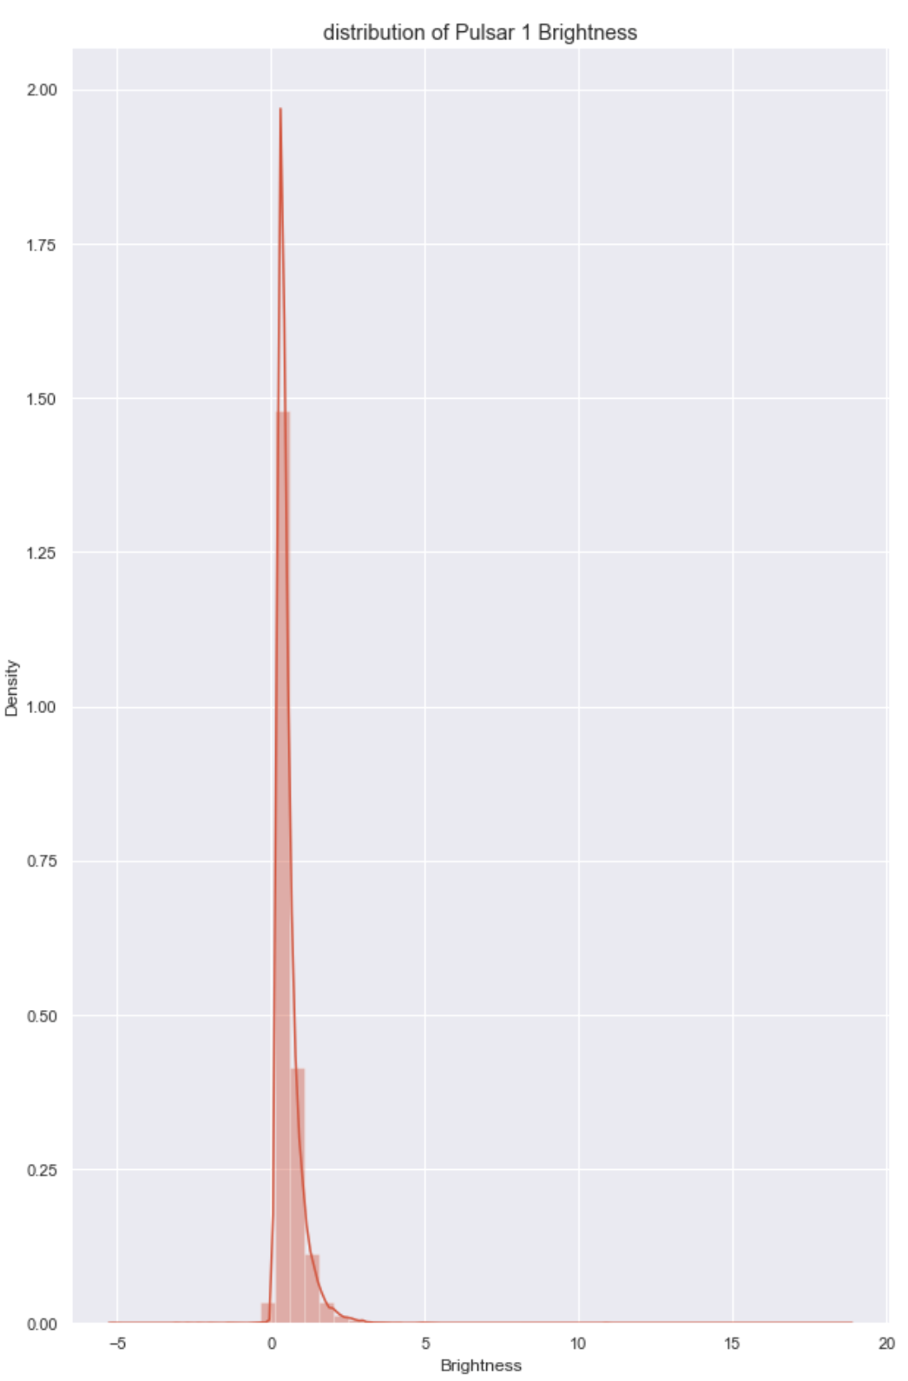
Distribution of the Plot
We check the distribution of pulsar where it tells us that there is no normality and we observe a positive right skewed distribution and most of values on brightness scale fall close to 0 with the largest brightness value around 3.
Notes:
Afeef

Slide 8
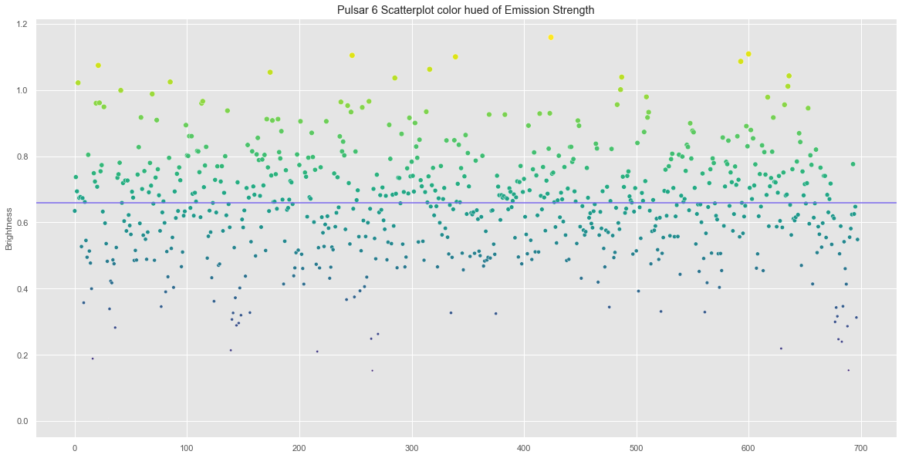
Analysis of the scatterplot
For this scatterplot, we observe the data points are randomly scattered and there is no observable pattern here as well.
The data points are divided into 1’s and 0’s for binary classification where the data points below the median line are 0 and above the median line is 1
Notes:
Afeef

Slide 9
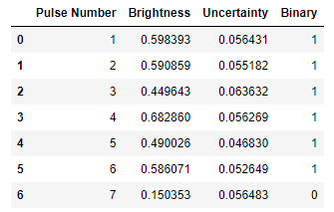
Binary Column
For our randomness tests, we need a binary sequence. We added a ‘Binary’ column which was established using the brightness median as a centre point. If a Brightness value was greater than the median it was assigned 1 if less than it was 0. This is the sequence we used for the randomness tests.
Fig: Binary column with “Brightness” median being 0.4238

Slide 10
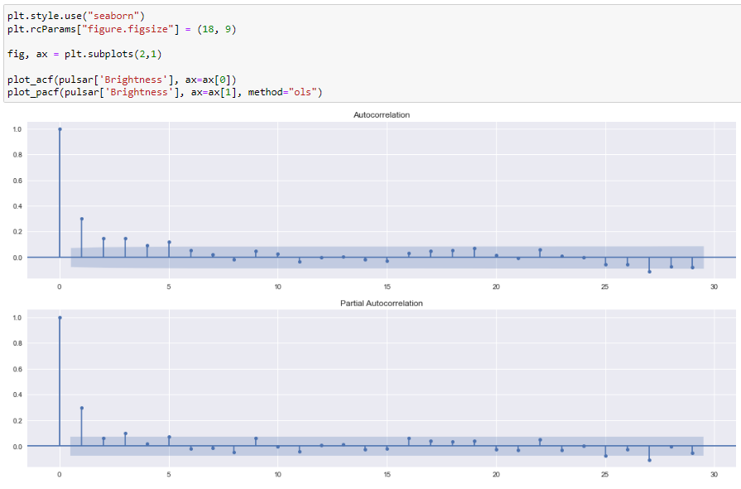
Autocorrelation
Autocorrelation represents the similarity between a given time series and a lagged version of itself over successive time intervals. Basically it measures the relationship between a variable’s current value and its past values. If we check the autocorrelation of this dataset’s brightness value, we can see that the interval is not statistically significant after 5. Therefore, a selection of every 5th is made.
Fig: Pulsar 3 ACF

Slide 11
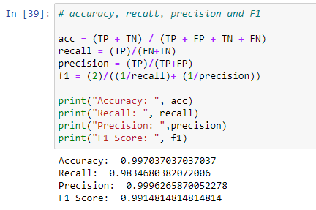
Machine Learning
Binary Classification: Classification problems with two class labels are referred to as binary classification. We used binary classification to predict the binary value of the data. The model predicted the values with more than optimal accuracy, recall, precision and F1 score which means the model is performing well but this did not help us further analyse the data.

Slide 12
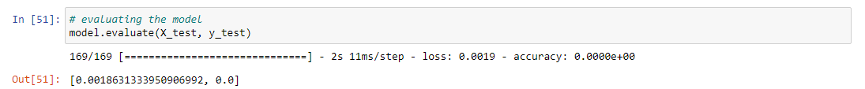
Machine Learning
Bidirectional LSTM Model: Bidirectional LSTM is the process of making any neural network to have the sequence information in both directions. This model helped us with the initial assessment of the data to see if it follows a certain trend/sequence. This model is often used to test pseudo-random numbers and it works significantly well. In this case, we used the “Brightness” and the “Uncertainty” values to train the model and the results showed us that no matter how many previous values we feed the value to predict the next value, it cannot find a sequence to correctly predict the correct value.

Slide 13
The Randomness Tests
16 different tests in NIST test suite
Frequency Test (Monobit) → equal proportions of 1’s and 0’s
Frequency Test within a Block → equal proportion of 1’s and 0’s in block
Run Test → total number of runs of k identical bits
Longest Run of Ones in a Block
Binary Matrix Rank Test → tests for linear dependence of substrings of the sequence
1 0 1 0 0 1 1 1 0 0 1 1 0 0 10
Notes:
Max

Slide 14
The Results
Pulsar 1
Every Observation
Frequency Test (Monobit) | Pass
Frequency Test within a Block | Fail
Run Test | Fail
Longest Run of Ones in a Block | Pass
Binary Matrix Rank Test | N/A
Total Passes | 3
Every 5th Observation
Frequency Test (Monobit) | Pass
Frequency Test within a Block | Pass
Run Test | Pass
Longest Run of Ones in a Block | Pass
Binary Matrix Rank Test | Pass
Total Passes | 5
𝛼 = 0.01
Notes:
Max

Slide 15
The Results
Pulsar 2
Every Observation
Frequency Test (Monobit) | Pass
Frequency Test within a Block | Fail
Run Test | Fail
Longest Run of Ones in a Block | Fail
Binary Matrix Rank Test | Pass
Total Passes | 2
Every 5th Observation
Frequency Test (Monobit) | Pass
Frequency Test within a Block | Pass
Run Test | Pass
Longest Run of Ones in a Block | Pass
Binary Matrix Rank Test | Pass
Total Passes | 5
𝛼 = 0.01
Notes:
Max

Slide 16
The Results
Pulsar 3
Every Observation
Frequency Test (Monobit) | Pass
Frequency Test within a Block | Pass
Run Test | Pass
Longest Run of Ones in a Block | Pass
Binary Matrix Rank Test | Pass
Total Passes | 5
Every 5th Observation
Frequency Test (Monobit) | Pass
Frequency Test within a Block | Pass
Run Test | Pass
Longest Run of Ones in a Block | Pass
Binary Matrix Rank Test | N/A
Total Passes | 4
𝛼 = 0.01
Notes:
Max

Slide 17
The Results
Pulsar 4
Every Observation
Frequency Test (Monobit) | Pass
Frequency Test within a Block | Fail
Run Test | Fail
Longest Run of Ones in a Block | Fail
Binary Matrix Rank Test | Pass
Total Passes | 2
Every 10th Observation
Frequency Test (Monobit) | Pass
Frequency Test within a Block | Pass
Run Test | Fail
Longest Run of Ones in a Block | Pass
Binary Matrix Rank Test | N/A
Total Passes | 3
𝛼 = 0.01
Notes:
Max

Slide 18
The Results
Pulsar 5
Every Observation
Frequency Test (Monobit) | Pass
Frequency Test within a Block | Pass
Run Test | Fail
Longest Run of Ones in a Block | Pass
Binary Matrix Rank Test | Pass
Total Passes | 4
Every 5th Observation
Frequency Test (Monobit) | Pass
Frequency Test within a Block | Pass
Run Test | Pass
Longest Run of Ones in a Block | Pass
Binary Matrix Rank Test | N/A
Total Passes | 4
𝛼 = 0.01
Notes:
Max

Slide 19
The Results
Pulsar 6
Every Observation
Frequency Test (Monobit) | Pass
Frequency Test within a Block | Pass
Run Test | Fail
Longest Run of Ones in a Block | Fail
Binary Matrix Rank Test | N/A
Total Passes | 2
Every 5th Observation
Frequency Test (Monobit) | Pass
Frequency Test within a Block | Pass
Run Test | Pass
Longest Run of Ones in a Block | Pass
Binary Matrix Rank Test | N/A
Total Passes | 4
𝛼 = 0.01
Notes:
Max

Slide 20
Which Pulsars are random?
From the previous slides we can confidently rule out using the 5 tests that we have interpreted as the most important. We can start to begin to either rule out randomness in a pulsar or not.
Notes:
Matt

Slide 21
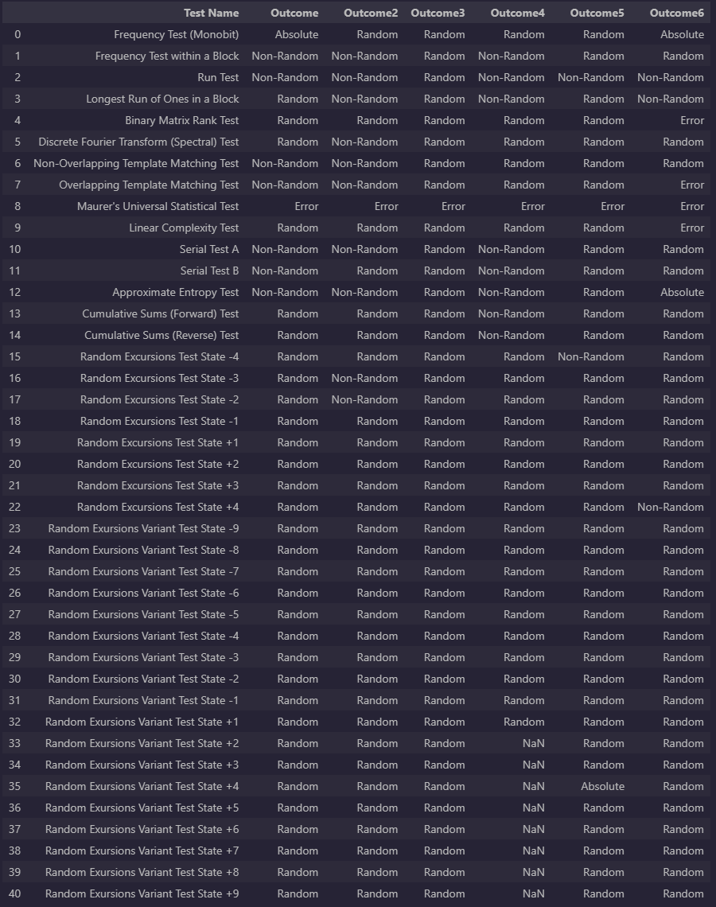
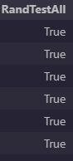
Pulsar observations ALL EMISSIONS
From both RandTest and NIST Suite we can say that.
Pulsars 3 & 5 are random - requires some more investigation into the errors and more. 5 could potentially be not random due to failure of the runs test (A fundamental test of randomness.)

Slide 22
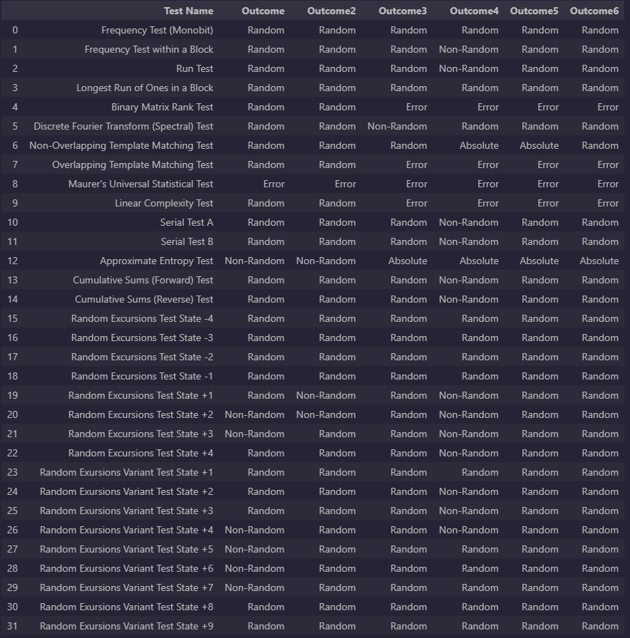
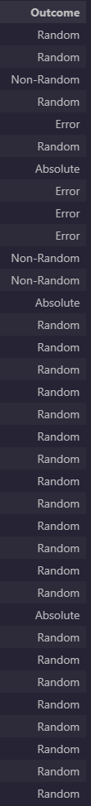
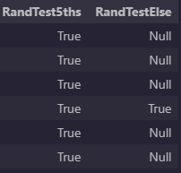
EVERY 5TH & 10th EMISSION
From both RandTest and NIST Suite we can say that.
Pulsars 1, 2, 3, 5 & 6 are likely to be random. Required some more investigation into the errors.

Slide 23
Summary Table
Designation | Assignment | All Emissions | Every 5th Emission | Every 10th Emission
J0437-4715 | Pulsar 1 | No | Yes | N/A
J0953+0755 | Pulsar 2 | No | Yes | N/A
J0835-4510 | Pulsar 3 | Yes | Yes | N/A
J1243-6423 | Pulsar 4 | No | No | Yes
J1456-6843 | Pulsar 5 | Yes | Yes | N/A
J1644-4559 | Pulsar 6 | No | Yes | N/A
Yes = Random | No = Non-Random

Slide 24
What didn't work in the project?
Kalman Filter didn’t work couldn’t get the coding to satisfy
Couldn’t get the binned statistics and rolling means and medians to find rewarding data.
Could not derive a dataset that could satisfy all NIST Tests to produce no errors.
Notes:
Matt

Slide 25
Further Recommendation for this study
More Pulsars and/or more observations
Analysis of different testing methods such as TestU01 and ent utility.
Further investigation of uncertainty.
Notes:
Matt

Slide 26
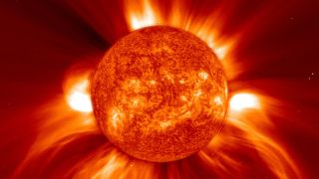
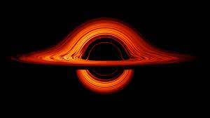
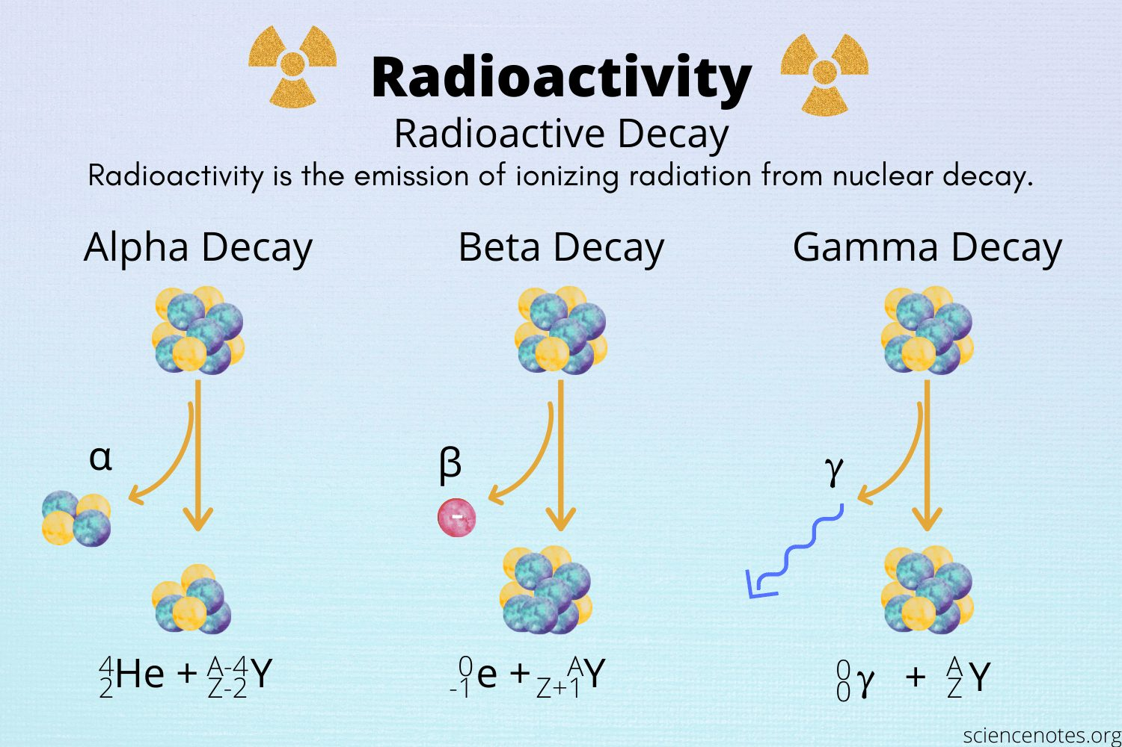
Further Recommendation for finding Randomness
Areas where we could find more randomness are abundant.
Sunspots and coronal mass ejections. (based on emission strength and appearance not location)
Black Hole Accretion disks - emissions of colliding objects
Radioactive Decay based on the specific atom not rate.
Notes:
Matt

Slide 27
CONCLUSION
Through this project we believe that we are confident in the areas we have undertaken:
Our Data analysis
Attempts of various methods to reward more data
Testing and interpretations
Results
Notes:
Matt

Slide 28
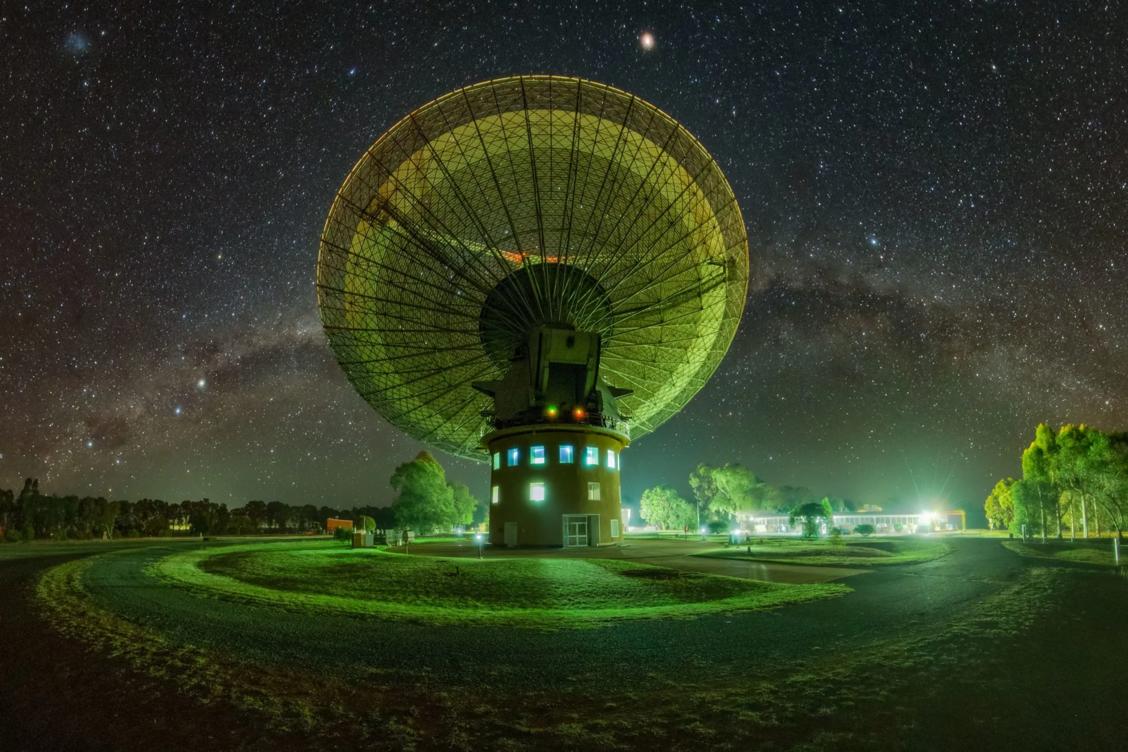
THANK YOU!
Afeef Ahmed
Alexandra Ellison
Matthew Oxley
Max Grant
Tajkinur Rahman

